Slide 1
Introduction to Data Science
Subject Code: CSDS7001
Dr. Sanoj Kumar School of Computer Science
University of Petroleum and Energy Studies, Dehradun
Email id: sanoj.kumar@ddn.upes.ac.in
Mb. Num.: 9058523010

Slide 2
Data
Definition: Data refers to facts, observations, measurements, or information that is typically in a raw and unorganized form. It represents the basic elements of information that are used to represent facts, concepts, or instructions in a way suitable for communication, interpretation, or processing by humans or machines.
Types of Data: Data can be classified into different types:
Numerical (quantitative) data (e.g., numbers),
Categorical (qualitative) data (e.g., labels or categories),
Text data, spatial data (e.g., geographic coordinates),
Temporal data (e.g., dates and times), and more.
Data Models
Definition: A data model is a conceptual representation or abstraction of the underlying structure and relationships within a dataset or a system.
It defines how data is organized and accessed. Data models can be used to represent data at various levels of abstraction, aiding in understanding and communication of the data's structure and properties.

Slide 3
Data Models
Data models provide a structured way to represent and organize data, allowing for efficient storage, retrieval, and manipulation. These models define how data is connected and how operations can be performed on that data. There are several types of data models used in various applications. Here are some common data models:
Relational Data Model:
Represents data as tables with rows and columns, where each row is a record and each column is an attribute.
Relationships between tables are established using keys.
Examples include SQL-based databases like MySQL, PostgreSQL.
Hierarchical Data Model:
Organizes data in a tree-like structure, where each record has a parent-child relationship.
Suitable for representing parent-child relationships in a natural way.
XML is a common representation of hierarchical data.

Slide 4
3. Network Data Model:
Extends the hierarchical model by allowing multiple parent-child relationships.
Records can have multiple parent and child records.
Less rigid than the hierarchical model.
Not widely used in practice.
4. Entity-Relationship Model:
Represents data in terms of entities, their attributes, and the relationships between them.
Widely used in database design and conceptual modeling.
5. Object-Oriented Data Model:
Organizes data into objects, where each object contains data and behavior (methods).
Reflects the structures and behaviors of real-world entities.
Commonly used in object-oriented programming languages and databases.

Slide 5
6. Document Data Model:
Stores data in a document format (e.g., JSON, BSON, XML).
Suitable for semi-structured or unstructured data.
Document-oriented databases like MongoDB use this model.
7. Key-Value Data Model:
Stores data as a collection of key-value pairs.
Fast and efficient for simple retrieval operations.
Used in distributed systems and caching mechanisms.
8. Time Series Data Model:
Specifically designed to handle time-ordered data.
Used for storing data collected over time, such as stock prices, weather data, or sensor readings.

Slide 6
9. Graph Data Model:
Represents data as graphs, consisting of nodes and edges.
Ideal for modeling relationships and connections between entities.
Used in social networks, recommendation systems, and network analysis.
10. Multi-dimensional Data Model:
Organizes data into multiple dimensions, allowing for OLAP operations.
Commonly used for data warehousing and business intelligence applications.
Understanding and selecting the appropriate data model for a specific application or system is critical for efficient data management, querying, and analysis. The choice of data model depends on the nature of the data, the application requirements, and the ease of representation and manipulation.

Slide 7
Types of Data Models
Purpose of Data Models:
Provide a clear, structured representation of the data and its relationships.
Assist in database design, ensuring data integrity and consistency.
Facilitate communication between stakeholders involved in data management and system development.
Guide the implementation of databases and information systems.

Slide 8
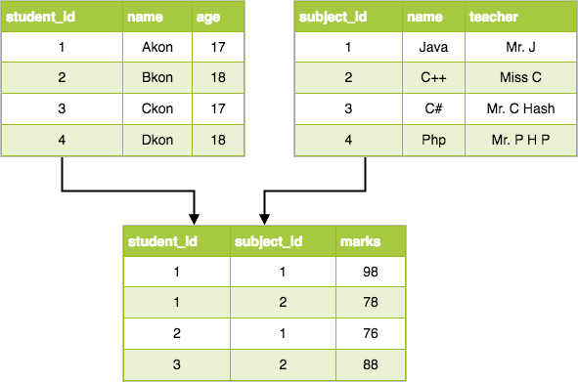
Types of Data Models
Relational Data Model: Represents data as tables (relations) consisting of rows and columns. It's widely used in databases and follows the principles of relational algebra.

Slide 9
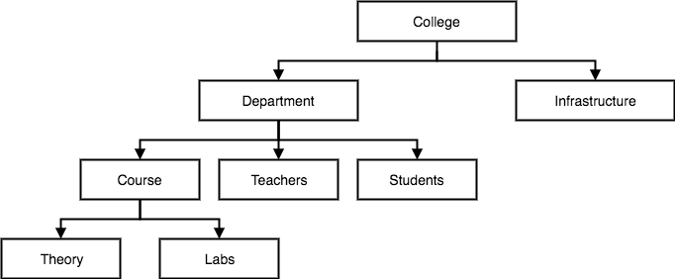
Types of Data Models
Hierarchical Data Model: Represents data as a tree-like structure, where each record has a parent and zero or more children. (IBM's Information Management System (IMS))

Slide 10
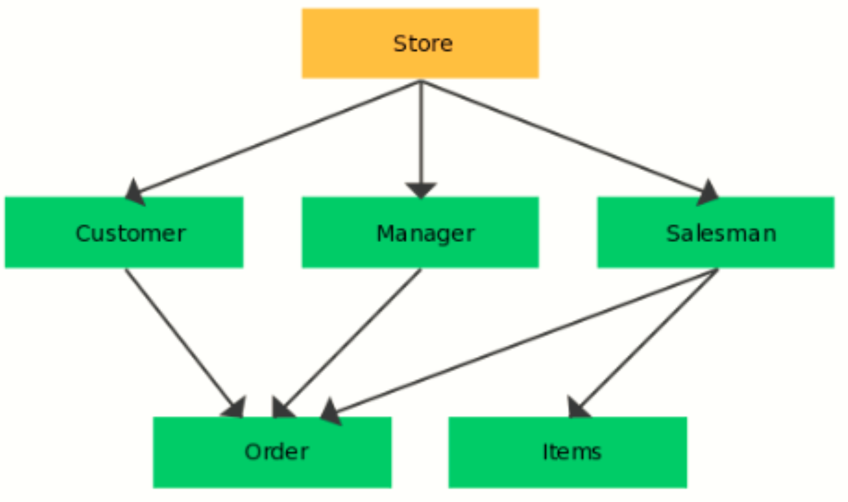
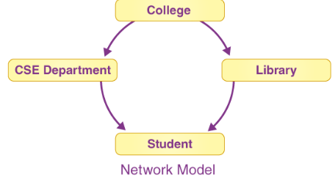
Types of Data Models
Network Data Model: Represents data as a more flexible structure than the hierarchical model, allowing multiple parent-child relationships.

Slide 11
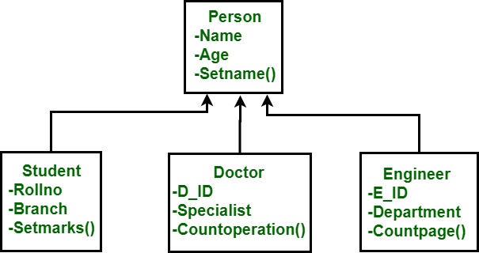
Types of Data Models
Object-Oriented Data Model: Represents data using objects, classes, and their relationships, similar to how object-oriented programming works.

Slide 12
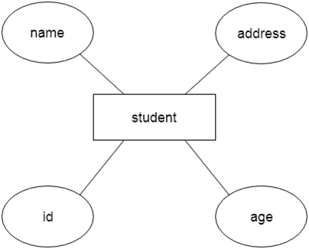
Types of Data Models
Entity-Relationship Model: Represents data in terms of entities, their attributes, and the relationships between them, aiding in database design.

Slide 13
Types of Data:
Numerical Data:
Continuous: Data that can take any numerical value within a range (e.g., height, weight).
Discrete: Data that can only take specific numerical values (e.g., number of cars, number of people).
Categorical Data:
Nominal: Categories with no inherent order or ranking (e.g., colors, types of fruit).
Ordinal: Categories with a meaningful order but not a consistent difference between them (e.g., education levels, customer satisfaction ratings).
Text Data:
Textual information, such as sentences, paragraphs, or documents (e.g., reviews, articles).
Time Series Data:
Data collected or recorded at specific time intervals (e.g., stock prices, weather data).

Slide 14
5. Spatial Data:
Data related to geographic locations or spatial features (e.g., GPS coordinates, maps).
6. Binary Data:
Data with only two possible values (e.g., yes/no, true/false).
7. Multi-dimensional Data:
Data with multiple dimensions or attributes (e.g., data in a data cube used in OLAP - Online Analytical Processing).
8. Image and Video Data:
Pixel values in the case of images or a sequence of images in the case of videos.
9. Audio Data:
Sound-related data, often represented as waveforms or spectrograms.

Slide 15
Types of Datasets:
Tabular Datasets:
Data organized in rows and columns (e.g., CSV files, Excel spreadsheets).
Relational Databases:
Datasets stored in a relational database management system (e.g., MySQL, PostgreSQL) with multiple interrelated tables.
Time Series Datasets:
Datasets where data is collected or recorded over a sequence of time intervals (e.g., financial market data, weather data).
Spatial Datasets:
Datasets containing geographic or spatial information (e.g., GIS data, maps).
Text Datasets:
Datasets containing textual information (e.g., books, articles, tweets).

Slide 16
6. Image Datasets:
Datasets consisting of image data (e.g., MNIST for handwritten digits, CIFAR-10 for small images).
7. Audio Datasets:
Datasets containing audio data (e.g., UrbanSound dataset for environmental sounds).
8. Graph Databases:
Datasets represented in the form of graphs, with nodes and edges representing relationships (e.g., social networks, citation networks).
9. Big Data Datasets:
Extremely large and complex datasets that conventional database systems struggle to handle efficiently (e.g., massive logs, sensor data).
10. Biomedical Datasets:
Datasets related to biomedical research and healthcare (e.g., genomic data, electronic health records).
Understanding the types of data and datasets is crucial in selecting appropriate methods and techniques for analysis, visualization, and processing in various domains and applications.

Slide 17
Data Quality
Data quality refers to the overall reliability, accuracy, consistency, completeness, and relevancy of data. It's a measure of the extent to which data can be relied upon for making decisions, conducting analysis, and performing various tasks. Ensuring high data quality is essential for effective and meaningful use of data. Here are key aspects related to data quality:
Accuracy:
Data accuracy measures how well the data reflects the true values or states of the entities it represents. Accurate data is free from errors and discrepancies.
Completeness:
Data completeness refers to whether all the required data is available. Missing or incomplete data can hinder the accuracy and reliability of analyses and insights.
Consistency:
Data consistency ensures that data across various sources or databases is uniform and coherent. Inconsistent data can lead to confusion and incorrect conclusions.

Slide 18
4. Timeliness:
Timely data is up to date and relevant for the present moment. Outdated data may not accurately represent the current situation.
5. Relevancy:
Relevant data is pertinent to the task at hand. Unnecessary or irrelevant data can clutter databases and complicate analyses.
6. Validity:
Validity is about whether the data conforms to the required format, structure, and constraints. Invalid data might not align with the defined rules or standards.
7. Integrity:
Data integrity ensures that the relationships between data elements are maintained, and there are no contradictions or discrepancies in the data.

Slide 19
8. Confidentiality:
Data confidentiality pertains to ensuring that sensitive or private information is protected and only accessible to authorized users.
9. Uniqueness:
Uniqueness ensures that each data record or entity is distinct and doesn't contain duplicate entries.
10. Precision:
Data precision refers to the level of detail or granularity in the data. Precise data is detailed and specific.
Improving data quality involves data cleaning, validation, data governance, and adherence to data quality standards. Techniques such as outlier detection, data profiling, and regular audits can help maintain and enhance data quality. High-quality data is vital for meaningful analysis, decision-making, and deriving valuable insights in various domains including business, healthcare, finance, and research.

Slide 20
Data Issues
Data issues encompass a range of problems, inconsistencies, or challenges related to the quality, reliability, and usability of data. Addressing these issues is crucial to ensure that the data can be effectively utilized for analysis, decision-making, and other purposes. Here are common data issues:
Missing Data:
Some records or fields have no values, making it challenging to perform analyses that require complete data.
Incomplete Data:
Data lacks certain expected attributes or components, making it difficult to derive meaningful insights or perform specific analyses.
Inaccurate Data:
Data contains errors, inaccuracies, or inconsistencies that may mislead analyses and decision-making processes.
Duplicate Data:
Multiple instances of the same data are present, potentially leading to skewed analysis or incorrect conclusions if not handled properly.

Slide 21
5. Inconsistent Data:
Data that is contradictory, conflicts with other data, or doesn't follow defined formats or standards.
6. Outliers:
Anomalies or outliers can distort statistical analyses and models, affecting the accuracy of results.
7. Bias:
Data is skewed towards certain values, leading to biased conclusions or unfair analysis outcomes.
8. Spelling and Formatting Errors:
Variations in spelling, capitalization, or formatting can make it challenging to standardize and analyze textual data.
9. Ambiguous or Vague Data:
Data that is poorly defined, vague, or ambiguous can cause misunderstandings and hinder accurate analysis.
10. Data from Multiple Sources:
Integration and merging of data from diverse sources can introduce inconsistencies or conflicts that need resolution.

Slide 22
11. Scale and Units:
Data measured in different units or scales can lead to confusion and incorrect interpretations.
12. Data Imbalance:
In classification tasks, one class of data significantly outweighs the others, which can bias machine learning models.
13. Temporal Issues:
Data lacks timestamps or has incorrect timestamps, making it challenging to analyze trends or time-sensitive patterns.
14. Data Privacy and Security Concerns:
Sensitive data might not be adequately protected, posing risks in terms of privacy and compliance with regulations.
To address these data issues, data cleaning, preprocessing, and transformation are essential steps. Employing data validation, employing data quality tools, conducting exploratory data analysis (EDA), and implementing appropriate data governance strategies are also critical to mitigate and rectify data issues. Ultimately, high-quality data is essential for accurate analysis, reliable insights, and informed decision-making.

Slide 23
Data Wrangling
The process of changing and mapping data from one "raw" data form into another format is known as "data wrangling“ which is also referred to as "data munging“. It is done with the intention of making the data more suitable and valuable for a number of purposes such as analytics, visualize etc. The purpose of cleaning and organising data is to ensure that the data are of high quality and useful. The process of "wrangling" the data often takes up the majority of a data analyst's work, as opposed to the actual "analysis" of the data.
The process of "wrangling" data may include "munging" the data further, "visualising" the data, "aggregating" the data, and "training" a statistical model, in addition to a great number of other possible applications. Data wrangling typically consists of a series of general steps, the first of which is the extraction of the data in its raw form from the data source, followed by "munging" the raw data (such as sorting) or parsing the data into predefined data structures, and then finally depositing the content that was generated into a data sink for storage and potential future use.

Slide 24
The main steps in data wrangling are as follows:
Data discovery
This all-encompassing term describes how to understand your data. This is the first step to familiarize yourself with your data.
Structuring
The next step is to organize the data. Raw data is typically unorganized and much of it may not be useful
for the end product. This step is important for easier computation and analysis in the later steps.
Cleaning
There are many different forms of cleaning data, for example one form of cleaning data is catching dates
formatted in a different way and another form is removing outliers that will skew results and also formatting
null values. This step is important in assuring the overall quality of the data.

Slide 25
Enriching
At this step determine whether or not additional data would benefit the data set that could be easily added.
Validating
This step is similar to structuring and cleaning. Use repetitive sequences of validation rules to assure data
consistency as well as quality and security. An example of a validation rule is confirming the accuracy of
fields via cross checking data.
Publishing
Prepare the data set for use downstream, which could include use for users or software. Be sure to
document any steps and logic during wrangling.
These steps are an iterative process that should yield a clean and usable data set that can then be used for analysis. This process is tedious but rewarding as it allows analysts to get the information they need out of a large set of data that would otherwise be unreadable.

Slide 26
Starting data
Name | Phone | Birth date | State
John, Smith | 445-881-4478 | August 12, 1989 | Maine
Jennifer Tal | +1-189-456-4513 | 11/12/1965 | Tx
Gates, Bill | (876)546-8165 | June 15, 72 | Kansas
Alan Fitch | 5493156648 | 2-6-1985 | Oh
Jacob Alan | 156-4896 | January 3 | Alabama

Slide 27
Resulting data
Name | Phone | Birth date | State
John Smith | 445-881-4478 | 1989-08-12 | Maine
Jennifer Tal | 189-456-4513 | 1965-11-12 | Texas
Bill Gates | 876-546-8165 | 1972-06-15 | Kansas
Alan Fitch | 549-315-6648 | 1985-02-06 | Ohio

Slide 28
Data Cleaning
The process of detecting and correcting (or removing) corrupt or inaccurate records from a record set, table, or database is known as data cleansing or data cleaning. It also refers to the identification of incomplete, incorrect, inaccurate, or irrelevant parts of the data, followed by the process of replacing, modifying, or deleting the dirty or coarse data. The process of cleaning data can be carried out in an interactive manner using data wrangling tools, or it can be carried out in a batch processing manner using scripting or a data quality firewall.

Slide 29
After being cleansed, a data set ought to be consistent with other data sets inside the system that are of a like kind. The discrepancies that were found or eliminated could have been caused initially by user entry errors, by corruption during transmission or storage, or by different data dictionary definitions of comparable entities in separate stores. Alternatively, the inconsistencies could have been generated by distinct data dictionaries. Data validation is different from data cleaning in that validation nearly always results in data being rejected from the system upon entry and is performed at the time of entry as opposed to on batches of data. Data cleaning, on the other hand, is performed on individual records.

Slide 30
Eliminating typographical errors or validating and correcting values by comparing them to a predetermined list of entities may be part of the actual process of data cleansing. The validation might be very stringent (for example, rejecting any address that does not have a valid postal code), or it could use fuzzy or approximate string matching (for example, updating records that only partially match known records). Some systems for cleaning data will clean it by cross-checking it with a data set that has already been validated. Enhancing data by including additional information that is relevant to it is a typical step in the process of data cleansing, also known as "data enrichment." For instance, attaching phone numbers to addresses and any other phone numbers that are associated with that address. The process of bringing together data with "various file formats, naming conventions, and columns" and transforming it into one cohesive data set is referred to as data harmonisation (or normalisation). A straightforward illustration of this process is the expansion of abbreviations, such as "st, rd, etc." to "street, road, etcetera."

Slide 31
Process for data cleaning
The process of data cleaning involves several steps to identify, handle, and rectify inconsistencies, errors, and inaccuracies in a dataset, making it suitable for analysis. Below is a structured process for data cleaning:
Understanding the Data:
Gain a comprehensive understanding of the dataset, its variables, and the domain it represents.
Preliminary Data Exploration:
Explore the dataset to identify missing values, duplicates, outliers, and any obvious issues.
Handling Missing Values:
Identify missing values in the dataset and choose an appropriate strategy:
Imputation: Fill missing values based on mean, median, mode, or other statistical methods.
Deletion: Remove records or columns with missing values.
Advanced imputation: Use machine learning models to predict missing values.

Slide 32
4. Handling Duplicates:
Identify and remove duplicate records to ensure data integrity and accuracy in analysis.
5. Handling Outliers:
Identify outliers using statistical methods or visualization techniques and choose an appropriate strategy:
Remove outliers if they are erroneous or irrelevant.
Transform outliers using techniques like winsorization or log transformation.
6. Standardizing Data Formats:
Standardize inconsistent data formats such as dates, phone numbers, or addresses to a common format.
7. Handling Inconsistencies:
Address inconsistencies in data values (e.g., typos, different representations) by standardizing or correcting them.
8. Handling Categorical Data:
Convert categorical data into numerical values using techniques like one-hot encoding or label encoding.

Slide 33
9. Data Type Conversion:
Ensure consistent data types for variables (e.g., numerical, categorical) based on their nature and analysis requirements.
10. Binning or Discretization:
Group continuous data into bins or categories for easier analysis or to prepare for modeling.
11. Feature Scaling:
Normalize or standardize numerical features to ensure they contribute equally during analysis.
12. Data Reconciliation:
Verify and reconcile the cleaned dataset with the original dataset to ensure data integrity is maintained.
13. Data Validation:
Apply validation rules and checks to ensure that data adheres to specified criteria and constraints.

Slide 34
14. Documenting the Process:
Keep detailed records of all cleaning steps, transformations, and decisions made during the process for transparency and reproducibility.
15. Data Profiling and Analysis:
Profile the cleaned dataset to ensure that the data is now ready for analysis.
Conduct exploratory data analysis (EDA) to gain insights and validate the effectiveness of the cleaning process.
16. Iteration and Feedback:
Iterate through the process based on the analysis results or feedback, and refine the cleaning steps if needed.
By following this structured process, you ensure that the data is clean, consistent, and ready for accurate analysis and modeling. Tailor the process to suit the specific characteristics and requirements of your dataset and analysis objectives.

Slide 35
Handling Numeric Data
1. Discretization:
Definition: Discretization is the process of transforming continuous numeric variables into discrete categories or bins.
Purpose:
Simplify analysis by reducing the number of unique values.
Prepare data for techniques that work better with categorical variables.
Methods:
Equal Width Binning: Divide the range of values into equal-sized bins.
Equal Frequency Binning: Divide the data into bins with an equal number of observations in each bin.
Custom Binning: Create bins based on domain knowledge or specific requirements.
Example:
Age Discretization: Grouping ages into categories like 'Child,' 'Adult,' and 'Senior.'

Slide 36
2. Binarization:
Definition: Binarization is the process of transforming numeric data into binary values (0 or 1) based on a threshold.
Purpose:
Simplify analysis by converting numerical values into a binary format.
Suitable for algorithms that require binary input.
Methods:
Simple Thresholding: Values above the threshold become 1, and below or equal become 0.
Adaptive Thresholding: Adjust the threshold dynamically based on local properties of the data.
Example:
Converting grayscale image pixels to black (0) or white (1) based on intensity threshold.

Slide 37
3. Normalization:
Definition: Normalization is the process of scaling numerical features to a standard range, typically [0, 1] or [-1, 1].
Purpose:
Ensure all features contribute equally to the analysis.
Avoid dominance of one feature due to its larger magnitude.
Methods:
Min-Max Scaling: Scale data to a specified range using the minimum and maximum values.
Z-Score Standardization: Transform data to have a mean of 0 and a standard deviation of 1.
Example:
Scaling exam scores (ranging from 0 to 100) to [0, 1] for uniform comparison.

Slide 38
4. Data Smoothing:
Definition: Data smoothing is the process of removing noise or irregularities from a dataset to reveal underlying patterns.
Purpose:
Enhance signal-to-noise ratio for better analysis.
Make data more interpretable by reducing complexity.
Methods:
Moving Averages: Replace each data point with the average of neighboring points.
Gaussian Smoothing: Convolve the data with a Gaussian kernel to reduce noise.
Examples:
Smoothing a stock price time series to visualize trends by applying a moving average.
Measurement of environmental temperature fluctuates due to various factors, causing unwanted noise in the dataset.
Quarterly sales data for a retail store displays fluctuating trends over time.
A biomedical signal (e.g., ECG) contains noise due to electrical interference. (Savitzky-Golay Smoothing)

Slide 39
Handling Different Types of Data

Slide 40
1. Dealing with Textual Data:
Preprocessing Text Data:
Tokenization: Breaking text into smaller units (words, phrases, symbols) known as tokens.
Stopword Removal: Removing common words (e.g., 'and', 'the') that carry little information.
Stemming and Lemmatization: Reducing words to their root form (e.g., 'running' to 'run').
Normalization: Converting text to a standard format (e.g., lowercase).
Text Vectorization:
Bag of Words (BoW): Represent text as a matrix of word counts.
Term Frequency-Inverse Document Frequency (TF-IDF): Assign weights to words based on their importance in a document relative to a corpus.
Word Embeddings: Represent words as dense vectors capturing semantic relationships (e.g., Word2Vec, GloVe).
Text Analysis:
Sentiment Analysis: Determine the sentiment (positive, negative, neutral) of text.
Topic Modeling: Identify key topics within a collection of documents (e.g., Latent Dirichlet Allocation, LDA).

Slide 41
2. Dealing with Images:
Preprocessing Image Data:
Resizing and Cropping: Adjusting images to a standard size for consistency.
Normalization: Scaling pixel values to a specific range (e.g., [0, 1]).
Data Augmentation: Generating additional training data by applying transformations like rotation, zoom, or flipping.

Slide 42
3. Dealing with Audio:
Preprocessing Audio Data:
Resampling: Standardizing the sampling rate for consistency.
Spectral Analysis: Transforming audio signals into frequency-domain representations (e.g., spectrograms).
Mel-Frequency Cepstral Coefficients (MFCCs): Extracting features for audio analysis.
Recurrent Neural Networks (RNNs):
Architecture: RNNs are used for sequential data like audio and text.
Applications: Speech recognition, language modeling.

Slide 43
4. Dealing with Video:
Preprocessing Video Data:
Frame Sampling: Extracting frames at a fixed interval to reduce data size.
Video to Images: Converting videos into a sequence of images for analysis.
Frame Preprocessing: Apply image preprocessing techniques to video frames.
Video Analysis:
Action Recognition: Identify actions or movements in video sequences.
Object Detection: Detect and track objects within video frames.
Optical Flow: Analysing motion between frames for action recognition.

Slide 44
5. Managing Categorical Attributes:
Encoding Categorical Data:
One-Hot Encoding: Create binary columns for each category.
Label Encoding: Assign a unique integer to each category.
Embedding: Map categorical variables to continuous vectors.
Dealing with High Cardinality:
Feature Engineering: Aggregate or transform categorical variables to reduce dimensionality.
Frequency-Based Encoding: Encode categories based on their frequency in the dataset.
Handling Ordinal Data:
Ordinal Encoding: Assign integers to categories based on their inherent order.
Custom Encoding: Create custom mapping functions for ordinal attributes.

